Slide 1


NALAN BESLI
NOVEMBER 2022

Slide 2

Outline
Executive Summary
Introduction
Methodology
Results
Conclusion
Appendix

Slide 3
Executive Summary
Summary of methodologies
Data Collection through API
Data Collection with Web Scraping
Data Wrangling
Exploratory Data Analysis with SQL
Exploratory Data Analysis with Data Visualization
Interactive Visual Analytics with Folium
Machine Learning Prediction
Summary of all results
Exploratory Data Analysis result
Interactive analytics in screenshots
Predictive Analytics result

Slide 4
Introduction
Project background and context
- Space X advertises Falcon 9 rocket launches on its website with a cost of 62 million dollars; other providers cost upward of 165 million dollars each, and much of the savings is because Space X can reuse the first stage. In this project, we will be to determine the price of each launch which depends on whether the first stage would land successfully to be reused. Using machine learning models and public data on Falcon 9, we will predict if SpaceX will reuse the first stage.
Problems you want to find answers
What are the main factors that determine if the rocket will land successfully?
What are the effects of each relationship of the rocket variables on the success or failure of a landing?
What operating conditions need to be in place to achieve the best landing success rate?

Slide 5

Section 1

Slide 6
Methodology
Executive Summary
Data collection methodology:
• SpaceX REST API • Web Scrapping from Wikipedia
Perform data wrangling
• Dropping unnecessary columns • One Hot Encoding for classification models
Perform exploratory data analysis (EDA) using visualization and SQL
Perform interactive visual analytics using Folium and Plotly Dash
Perform predictive analysis using classification models
How to build, tune, evaluate classification models

Slide 7
Data Collection
Data collection was done using get request to the SpaceX API.
Next, we decoded the response content as a Json using .json() function call and turn it into a pandas dataframe using .json_normalize().
We then cleaned the data, checked for missing values and fill in missing values where necessary.
In addition, we performed web scraping from Wikipedia for Falcon 9 launch records with BeautifulSoup.
The objective was to extract the launch records as HTML table, parse the table and convert it to a pandas dataframe for future analysis.
SpaceX Rest API call
Make Dataframe from JSON
API returns JSON file
Clean Data and export it

Slide 8
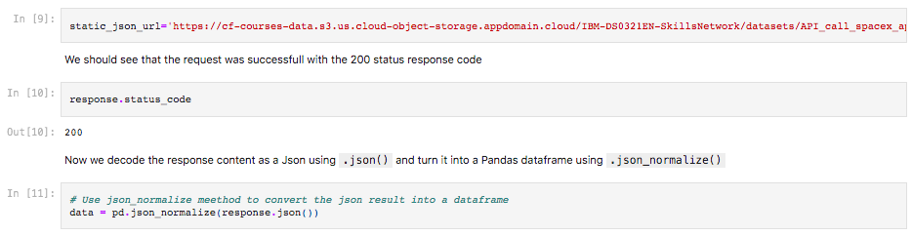
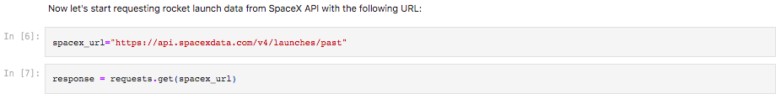
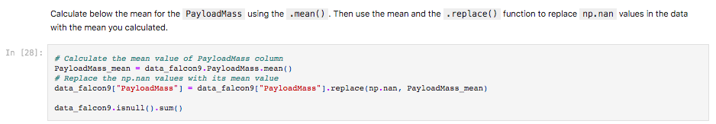
Data Collection – SpaceX API
We used the get request to the SpaceX API to collect data, clean the requested data and did some basic data wrangling and formatting.
Code link

Slide 9
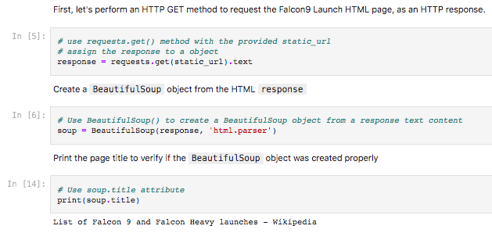
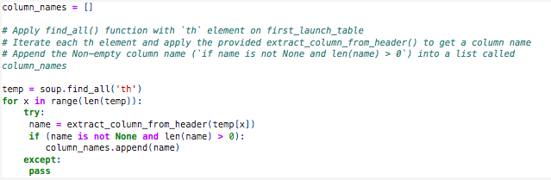
Data Collection - Scraping
We scraped Falcon 9 launch data from Wikipedia with BeautifulSoup.
We parsed the table and converted it into pandas dataframe.
Code link

Slide 10
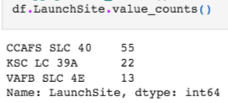
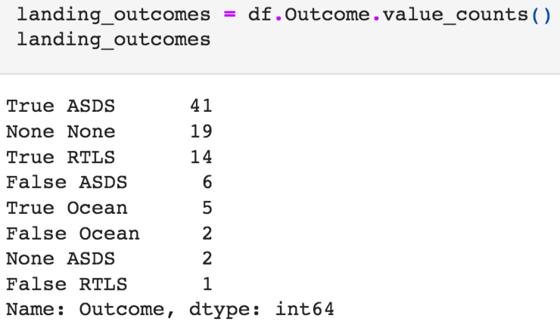
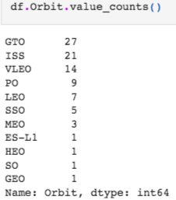
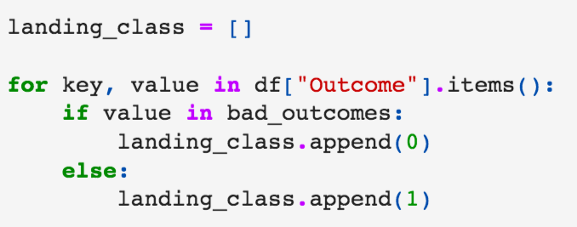
Data Wrangling
We calculated the number of launches at each site and the number and occurrence of each orbits.
We transformed variables into categorical variables 1 and 0 and exported the results to cvs.
Code link

Slide 11
EDA with Data Visualization
We explored the data by visualizing the relationship between flight number and launch Site, payload and launch site, success rate of each orbit type, flight number and orbit type, the launch success yearly trend with scatter plots, bar graphs and line graphs.
Scatter plots show relationship between variables. This relationship is called the correlation.
Bar graphs show the relationship between numeric and categoric variables.
Line graphs show data variables and their trends. Line graphs can help to show global behavior and make prediction for unseen data.
Code link

Slide 12
EDA with SQL
We loaded the SpaceX dataset into a PostgreSQL database without leaving the jupyter notebook.
We applied EDA with SQL to get insight from the data.
We wrote queries for:
Displaying the names of the unique launch sites in the space mission.
Display 5 records where launch sites begin with the string 'CCA'
Display the total payload mass carried by boosters launched by NASA (CRS).
Display average payload mass carried by booster version F9 v1.1.
List the date when the first successful landing outcome in ground pad was achieved.
List the names of the boosters which have success in drone ship and have payload mass greater than 4000 but less than 6000.
List the total number of successful and failure mission outcomes.
List the names of the booster_versions which have carried the maximum payload mass.
List the records which will display the month names, failure landing_outcomes in drone ship, booster versions, launch_site for the months in year 2015.
Rank the count of successful landing_outcomes between the date 04-06-2010 and 20-03-2017 in descending order. Link to code
Code link

Slide 13
Build an Interactive Map with Folium
Marked all launch sites, and added map objects such as markers, circles, lines to mark the success or failure of launches for each site on the folium map.
We assigned the feature launch outcomes (failure or success) to class 0 and 1, 0 for failure, and 1 for success.
Using the color-labeled markers to show successful and unsuccessful landings. Green for successful landing and Red for unsuccessful landing, we can see which launch sites have relatively high success rate.
We calculated the distances between a launch site to key locations like railway, highway, coastway, city, and plot a line between them.
Code link

Slide 14
Build a Dashboard with Plotly Dash
Built an interactive dashboard with Plotly dash.
Pie charts showing the total launches by a certain sites
Scatter graph showing the relationship with Outcome and Payload Mass (Kg) for the different booster version.
Code link

Slide 15
Predictive Analysis (Classification)
Data preparation
Load the data using numpy and pandas, normalized the data, split data into training set and testing set.
Model preparation
Select machine learning algorithms, set parameters for each algorithm to GridSearchCV than train GridSearchModel models with training dataset.
Model evaluation
Get best hyperparameters for each type of model than compute accuracy for each model with test dataset than plot confusion matrix.
Model comparison
Compare models according to their accuracy then choose the model with the best accuracy.
Code link

Slide 16
Results
Exploratory data analysis results
Interactive analytics demo in screenshots
Predictive analysis results

Slide 17

Section 2

Slide 18
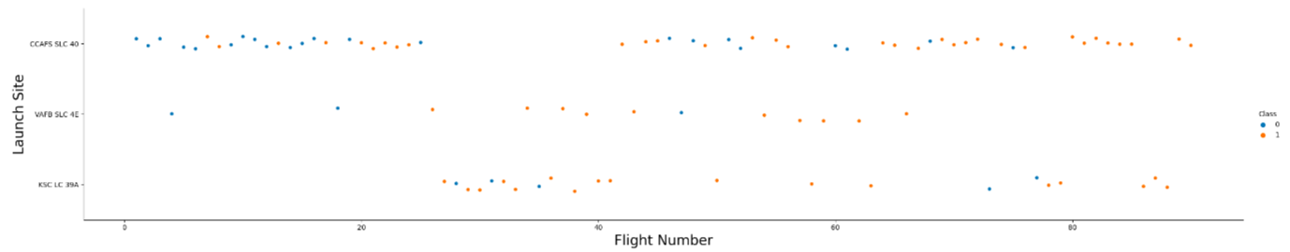
Flight Number vs. Launch Site
From the plot, we can see that the larger the flight number at a launch site, the greater the success rate.

Slide 19
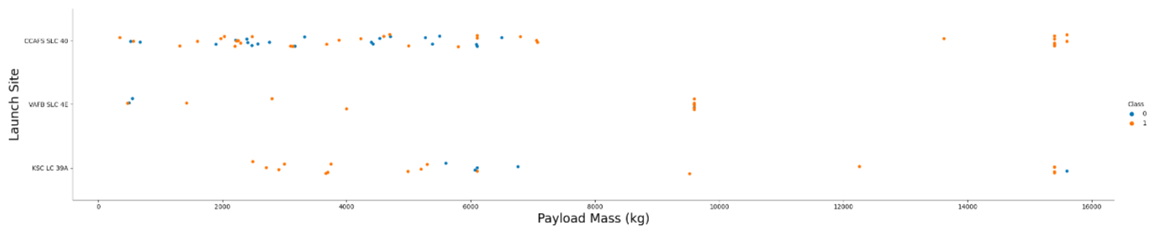
Payload vs. Launch Site
Depending on the launch site, a heavier payload may be a consideration for a successful landing.

Slide 20
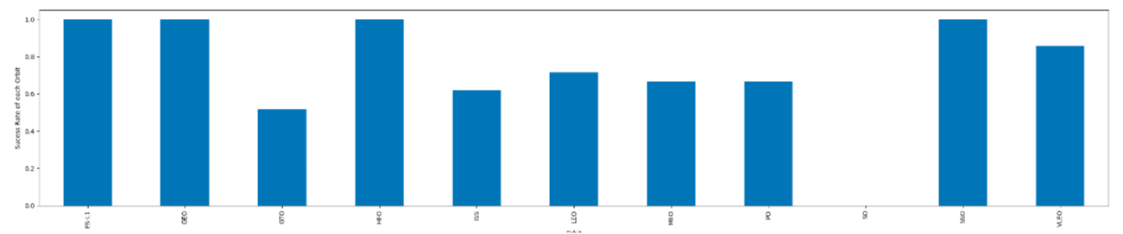
Success Rate vs. Orbit Type
This plot shows the success rate for different orbit types. We can see ES-L1, GEO, HEO, SSO have the best success rate.

Slide 21
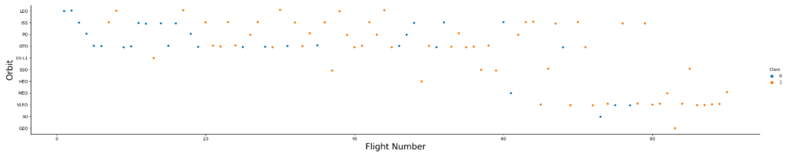
Flight Number vs. Orbit Type
We can see that the success rate increases with the number of flights for the LEO orbit. For some orbits like GTO, there is no relation between the success rate and the number of flights.

Slide 22
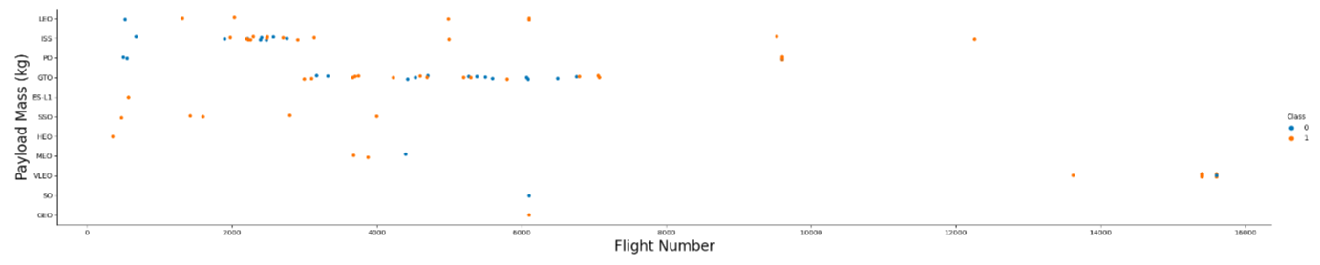
Payload vs. Orbit Type
The weight of the payloads can have a great influence on the success rate of the launches in certain orbits. We can see that with heavy payloads, the successful landing are more for PO, LEO and ISS orbits.

Slide 23
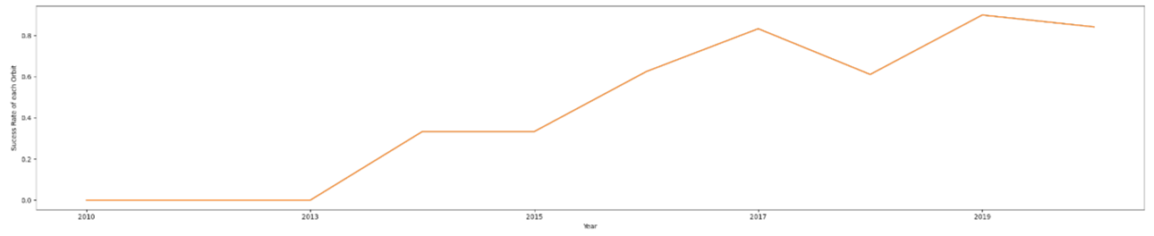
Launch Success Yearly Trend
Since 2013, we can see an increase in the Space X Rocket success rate.

Slide 24
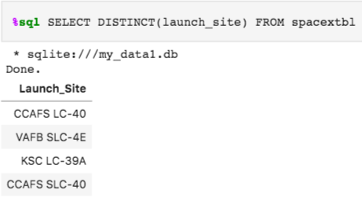
All Launch Site Names
The use of the key word DISTINCT is showing only unique launch sites from the SpaceX data.

Slide 25
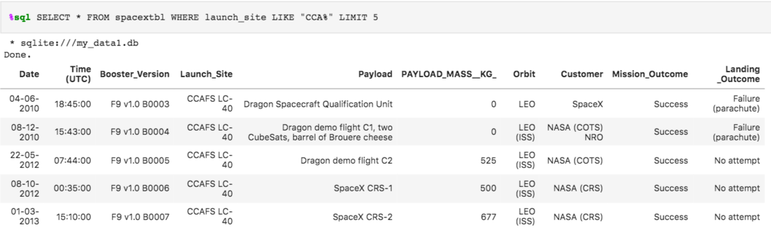
Launch Site Names Begin with 'CCA'
The query above displays 5 records where launch sites begin with `CCA`.

Slide 26
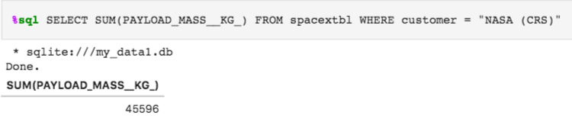
Total Payload Mass
The total payload carried by boosters from NASA is shown using the query above.

Slide 27
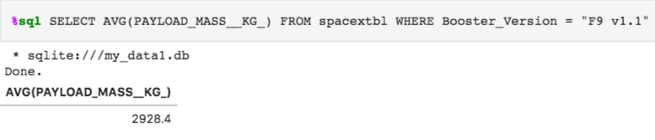
Average Payload Mass by F9 v1.1
This query returns the average of all payload masses where the booster version contains the substring F9 v1.1.

Slide 28
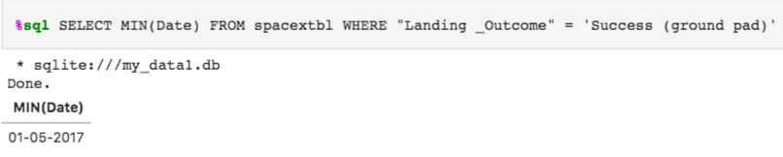
First Successful Ground Landing Date
With this query, we select the oldest successful landing with WHERE clause and MIN function .

Slide 29
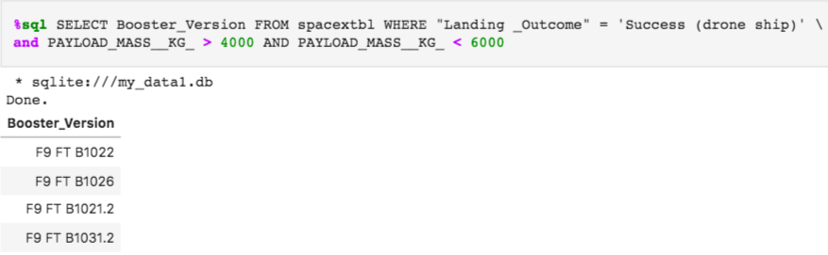
Successful Drone Ship Landing with Payload between 4000 and 6000
This query returns the booster version where landing was successful and payload mass is between 4000 - 6000 kg. The WHERE and AND clauses filter the dataset.

Slide 30
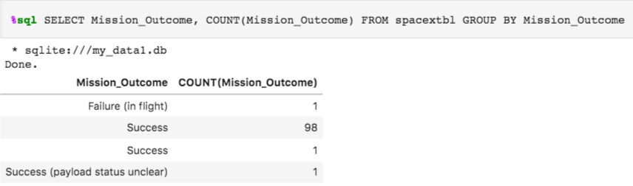
Total Number of Successful and Failure Mission Outcomes
Sorted results with GROUP BY if the Mission Outcome was a success or a failure. The COUNT function counts records filtered.

Slide 31
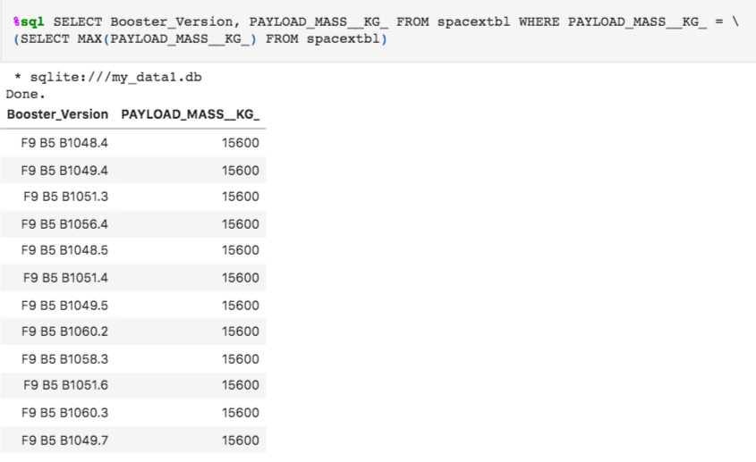
Boosters Carried Maximum Payload
Used subquery to filter data by returning only the heaviest payload mass with MAX function.

Slide 32
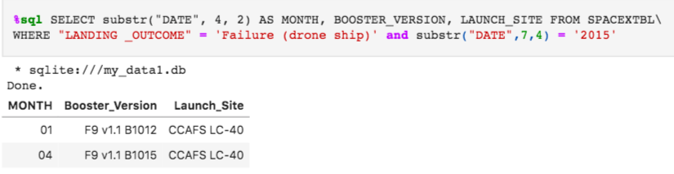
2015 Launch Records
This query returns month, booster version, launch site where landing was unsuccessful and landing date took place in 2015. Substr function process date in order to take month or year. Substr(DATE, 4, 2) shows month. Substr(DATE,7, 4) shows year.

Slide 33
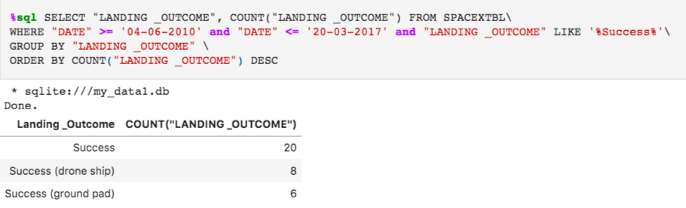
Rank Landing Outcomes Between 2010-06-04 and 2017-03-20
This query returns landing outcomes and their count where mission was successful and date is between 04/06/2010 and 20/03/2017. The GROUP BY clause groups results by landing outcome and ORDER BY COUNT DESC shows results in decreasing order.

Slide 34

Section 3

Slide 35
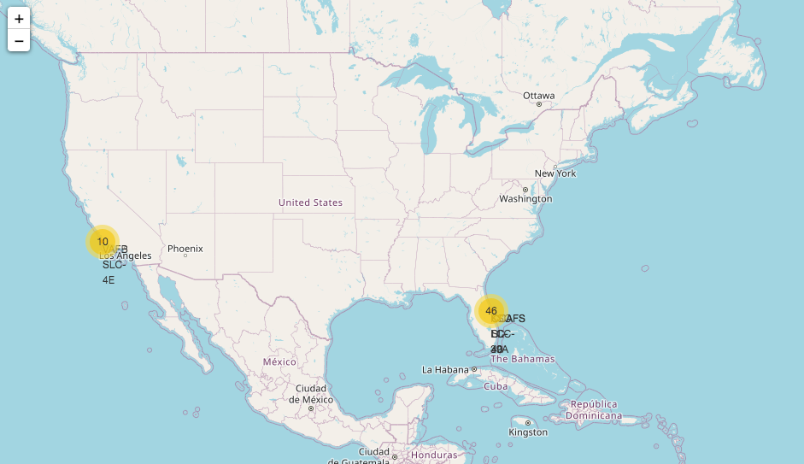
All launch sites global map markers
We can see that Space X launch sites are located on the coast of the United States.

Slide 36
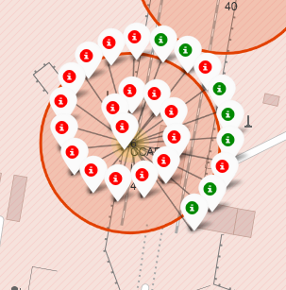
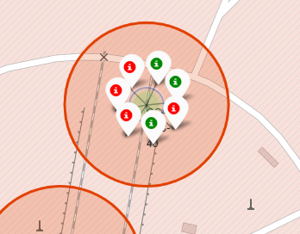
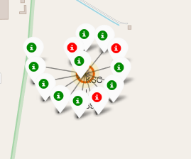
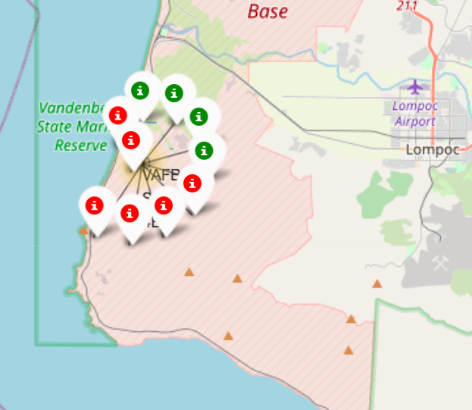
Markers showing launch sites with color labels
Green marker represents successful launches. Red marker represents unsuccessful launches.

Slide 37
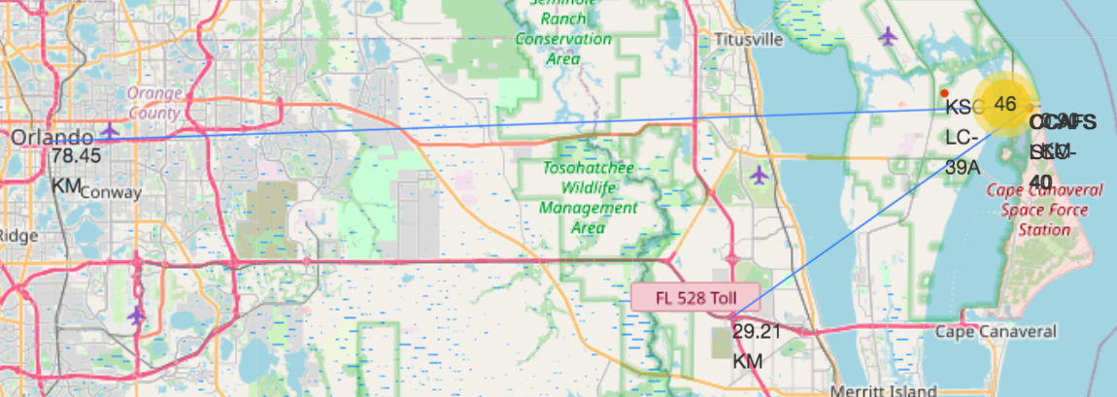
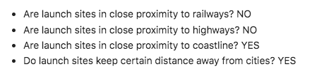
Launch Site distance to landmarks

Slide 38

Section 4

Slide 39
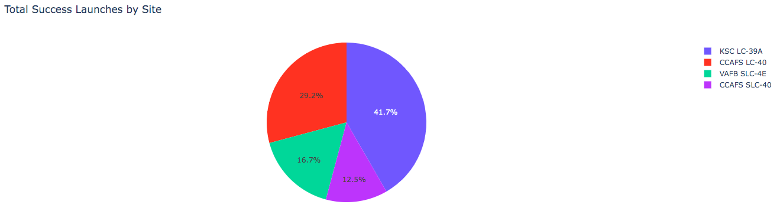
Pie chart showing the success percentage by each launch site
We can see that KSC LC-39A has the best success rate.

Slide 40
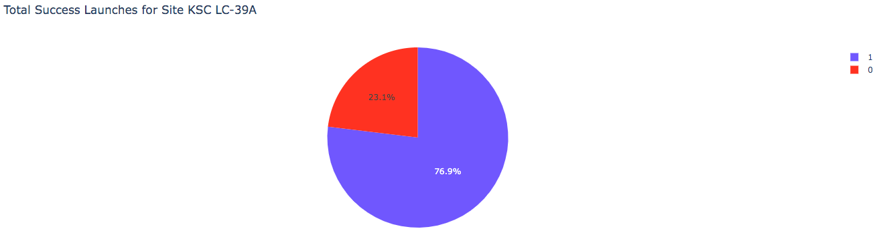
Pie chart showing the Launch site with the highest launch success ratio
We can see that KSC LC-39A has 76.9% success rate and 23.1% failure rate.

Slide 41
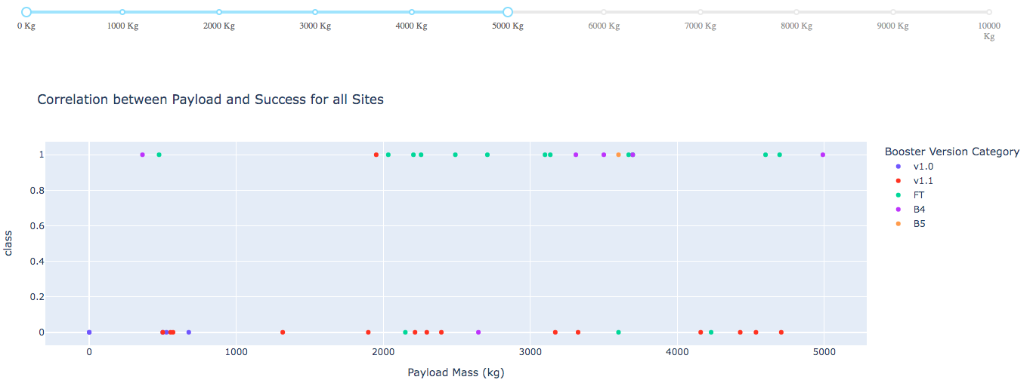
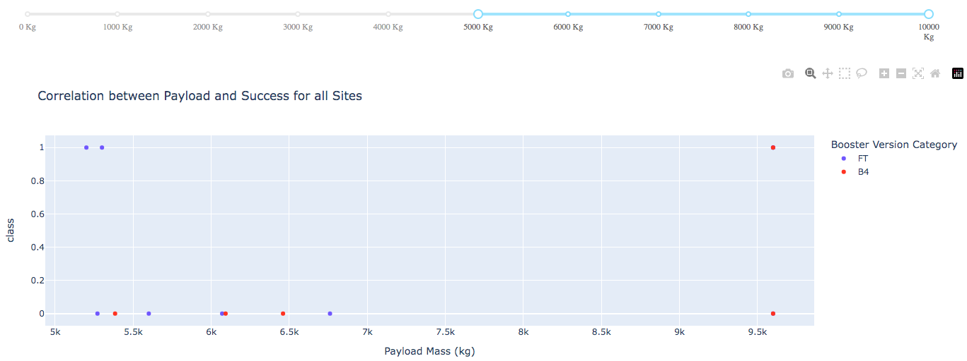
Scatter plot of Payload vs Launch Outcome for all sites
Low weighted payloads have a better success rate than the heavy weighted payloads.

Slide 42

Section 5

Slide 43
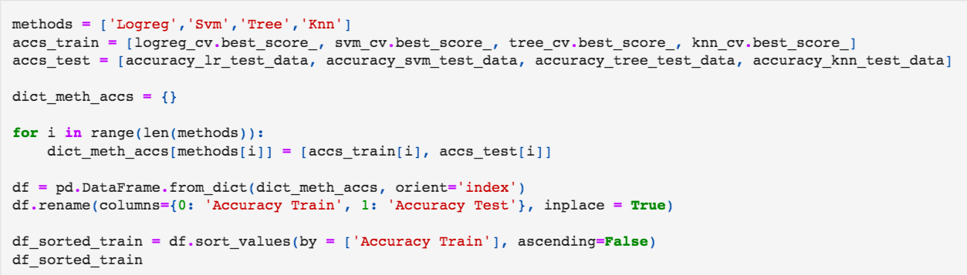
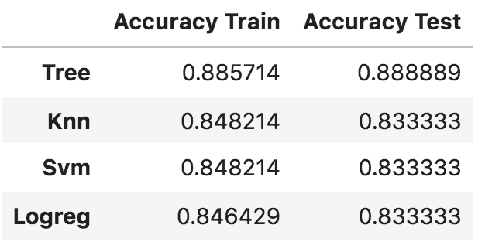
Classification Accuracy
For accuracy test, all methods performed similar. We could get more test data to decide between them. But the decision tree classifier is the model with the highest classification accuracy

Slide 44
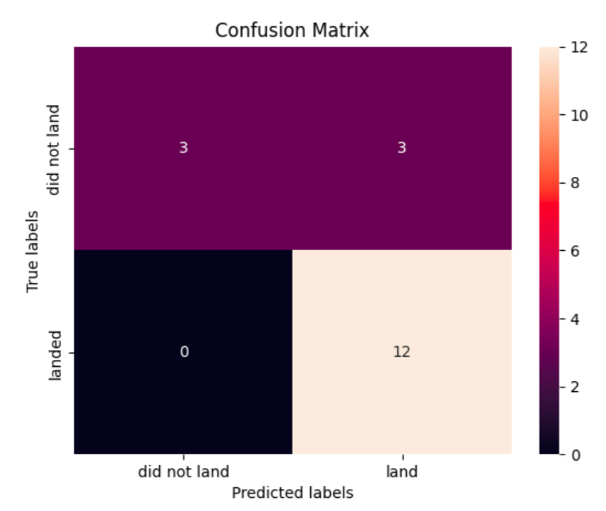
Confusion Matrix
This is the confusion matrix for the decision tree classifier but the confusion matrices for all methods were identical .
The main problem of these models are false positives (unsuccessful landing marked as successful landing).

Slide 45
Conclusions
The larger the flight amount at a launch site, the greater the success rate at a launch site.
Depending on the launch site, a heavier payload may consideration for a successful landing.
Orbits ES-L1, GEO, HEO, SSO, VLEO had the most success rate.
KSC LC-39A had the most successful launches of any sites.
Since 2013, we can see an increase in the Space X Rocket success rate.
All methods performed similar but the decision tree classifier is the best machine learning algorithm for this task.

Slide 46


